Slide 1
Emergency Vehicle Signal Preemption Optimization
With Connected Vehicle Technology In Gwinnett County
Status update
September 21, 2020

Slide 2
Objectives
Evaluate the impact of signal preemption on delays experienced by fire response vehicles around the Peachtree Industrial Boulevard study corridor.
Develop methodologies and algorithms for tuning parameters relevant to preemption operation across consecutive intersections, such that emergency vehicle travel time is minimized.

Slide 3
Tasks
Literature Review
Pre-deployment Data Collection
Pre-deployment Data Analysis
Predictive Preemption Methodology Development
Post-deployment Data Collection
Before-after Evaluation
Draft and Final Report

Slide 4
Task 3: Predictive Preemption Methodology
Software in the Loop Simulation Model (VISSIM + MaxTime)
Calibration with MaxView Volumes
Validation with base Firetruck Delays
Test Basic Preemption Scenarios (MaxTime logic)
Develop & Test Predictive Preemption logic

Slide 5
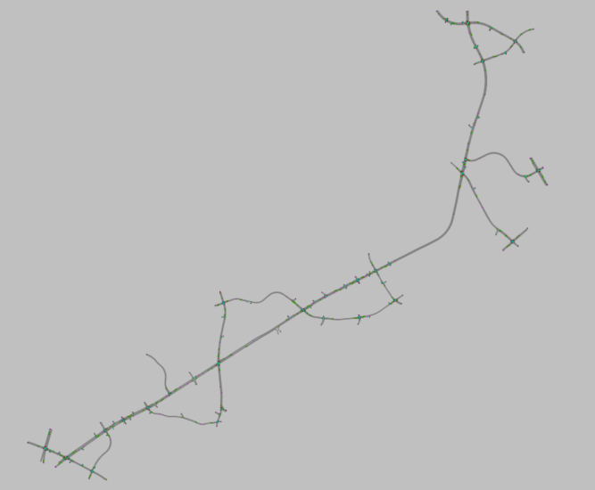
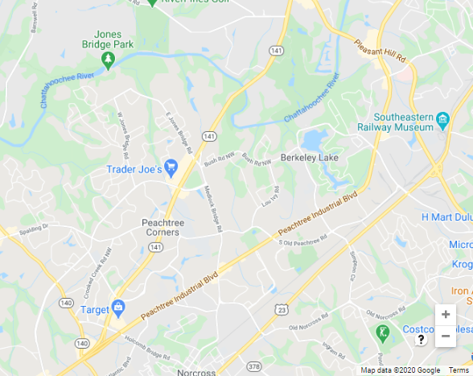
Current VISSIM Model: Peachtree Industrial Boulevard
It stretches along Peachtree Industrial Boulevard from Holcomb Br Rd to Pleasant Hill Rd covering 25 intersections

Slide 6
Architecture: Connecting MAXTIME with VISSIM
Historic Volume Data
SOFTWARE IN THE LOOP
MaxTime Detector Data: Sep 01, 2019
VISSIM COM Interface
(Python 3.7)
Calibration
+
Volume Input
Short-term Turn Counts
ARC’s ABM20 Counts (Modeled)
MAXTIME 2.0
Instance 1 for Signal 1
Validation
VISSIM Model (25 Signalized Intersections)
Vehicle Detections
MAXTIME 2.0
Instance 2 for Signal 2
MAXTIME 2.0
Instance X for Signal X
Emergency Vehicle GPS Data
Signal Status
Instance 1 for Signal 1
Individual instances for each intersection

Slide 7
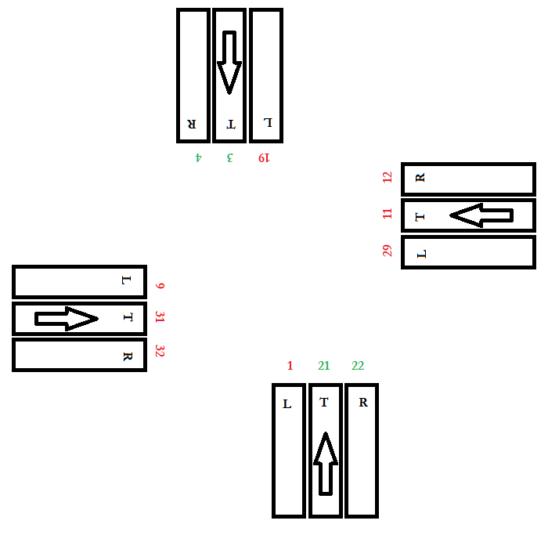
Volume Data Sources
Detector pulses are accumulated every 5 min to create a 5 min volume aggregate inputs
Only detectors in the main lines are pulse detectors, which means only those movements provide actual volume counts.
The volume of the side streets are estimated from short-term turn volume count field data
Use ARC’s ABM20 modeled data for volumes and turn-ratios where no other data is available
Historic Volume Data
MaxTime Detector Data: Sep 01, 2019
Short-term Turn Counts
ARC’s ABM20 Counts (Modeled)
Notes:
Detector image (presence, pulse)
Estimated from short term turn volume counts (aad)

Slide 8
Volume Data Availability
Turn counts are available only at a few intersections (7 out of 25 that are marked in green)
Turn counts are currently imputed for the “data-missing” intersections using the ones available
Investigating feasibility of ARC’s ABM20 model to generate turn volume data for the missing intersection approaches
Intersection ID | Main Street | Side Street | Present Detectors
185 | SR 141 / PEACHTREE PKWY | HOLCOMB BRIDGE RD | 3-4
173 | SR 140 CONN / PEACHTREE IND BLVD | HOLCOMB BRIDGE RD | 3-4-21-22
629 | HOLCOMB BRIDGE RD | ATLANTIC BLVD
638 | SR 13 ALT / PEACHTREE IND BLVD | PEACHTREE CORNERS EAST
859 | PIB | NORCROSS STEM HS | 3-4-21-22
650 | SR 13 ALT / PEACHTREE IND BLVD | REPS MILLER RD | 3-4-22
646 | SR 13 ALT / PEACHTREE IND BLVD | TECHNOLOGY PKWY SOUTH | 3-4-21-22
617 | N. PEACHTREE ST | REPS MILLER RD / BISHOPS CROSSING
605 | MEDLOCK BRIDGE RD / LANGFORD RD | NORTH PEACHTREE ST
631 | SR 13 ALT / PEACHTREE IND BLVD | MEDLOCK BRIDGE RD | 3-21-22
641 | MEDLOCK BRIDGE RD | SPALDING DR / SOUTH OLD PEACHTREE RD
632 | SR 13 ALT / PEACHTREE IND BLVD | SOUTH OLD PEACHTREE RD | 3-4-21
767 | SR 13 ALT / PEACHTREE IND BLVD | HIGHWOODS CENTER | 3-4-21-22
669 | S. OLD PEACHTREE | PICKNEYVILLE PARK / SOCCER COMPLEX
673 | PEACHTREE IND BLVD | PICKNEYVILLE PARK / COMMONS GATE BEND | 3-4-21-22
635 | SR 13 ALT / PEACHTREE IND BLVD | SOUTH BERKELEY LAKE RD | 3-4-21-22
606 | SOUTH BERKELEY LAKE RD | SOUTH OLD PEACHTREE RD
633 | SR 13 ALT / PEACHTREE IND BLVD | NORTH BERKELEY LAKE RD | 3-4-21-22
671 | SR 13 ALT / PEACHTREE IND BLVD | SUMMITT RIDGE PKWY / SWEETWATER CENTER | 3-4-21-22
660 | SR 13 ALT / PEACHTREE IND BLVD | HOWELL FERRY RD | 3-4-21-22
692 | PLEASANT HILL RD | PEACHTREE HILL S/C / BOSTON MARKET | 21-22
661 | SR 13 ALT / PEACHTREE IND BLVD | PLEASANT HILL RD | 3-4-21-22
662 | PLEASANT HILL RD | HOWELL FERRY RD / MCCLURE BRIDGE RD | 3-4-21-22
696 | PLEASANT HILL RD | DULUTH MS / SUMMIT RIDGE PKWY
598 | US 23 / SR 13 / BUFORD HWY | NORTH BERKELEY LAKE RD
Notes:
Green= turn counts given
Red: volume detectors missing

Slide 9
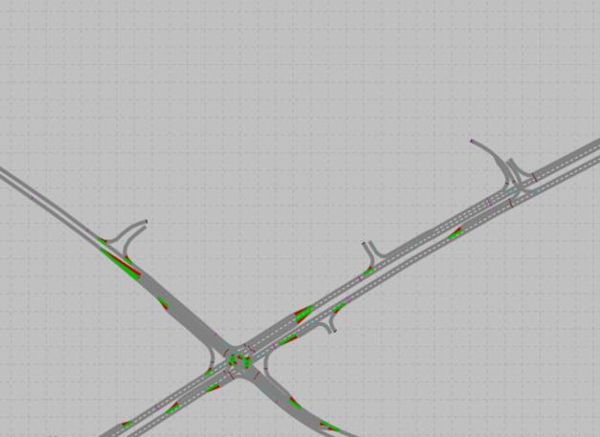
Volume Balancing
Based on the detector data and turn counts of the adjacent intersections, the number of vehicles coming into an intersection may not equate with the number of vehicles .
In those cases, parking lots are placed to balance out the volume.

Slide 10
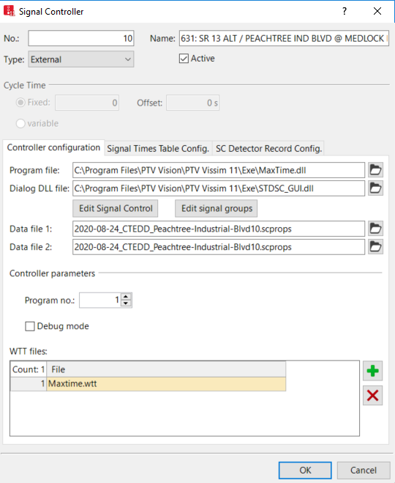
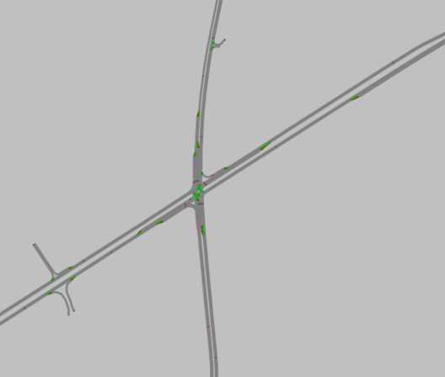
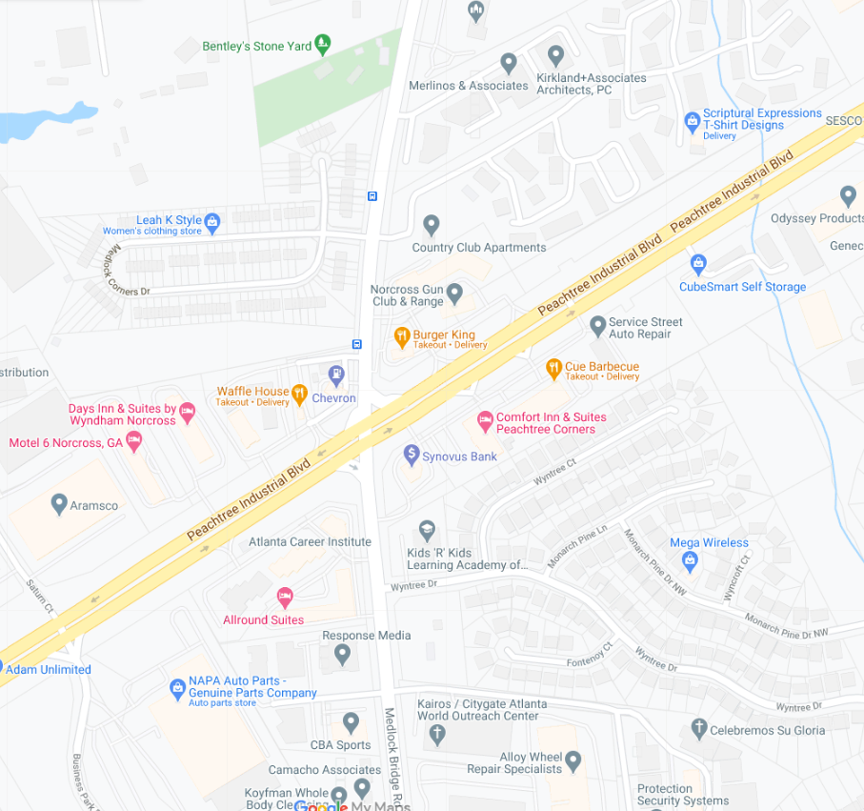
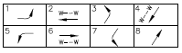
Signal: MAXTIME-VISSIM Connection
Based on actual phasing information, the signals are added in VISSIM and the appropriate DLL files are used to establish the connection of VISSIM to MAXTIME
Notes:
Phase diagram mapping
Matching ports (indicated)

Slide 11
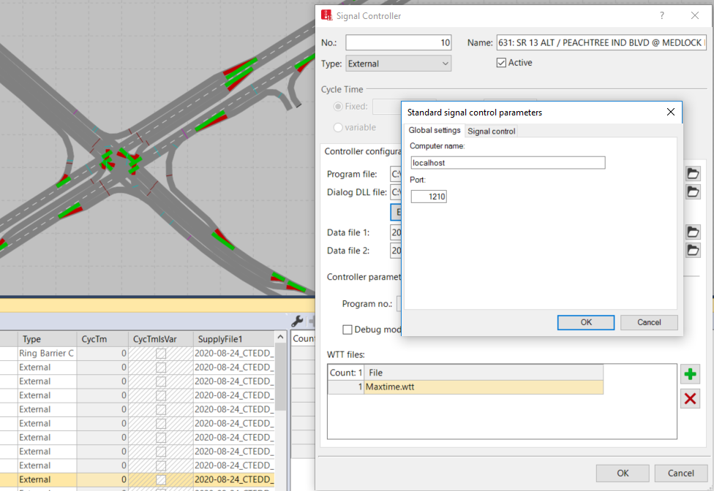
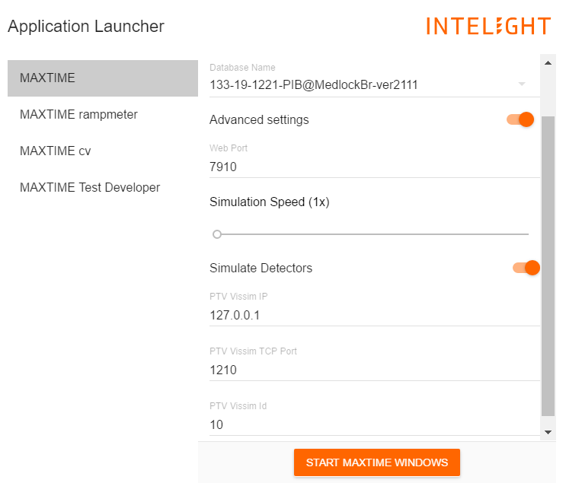
Signal: MAXTIME-VISSIM Connection (Continued)
Each signal group in VISSIM needs to be connected to separate instance of MAXTIME in parallel
Notes:
Phase diagram mapping
Matching ports (indicated)

Slide 12
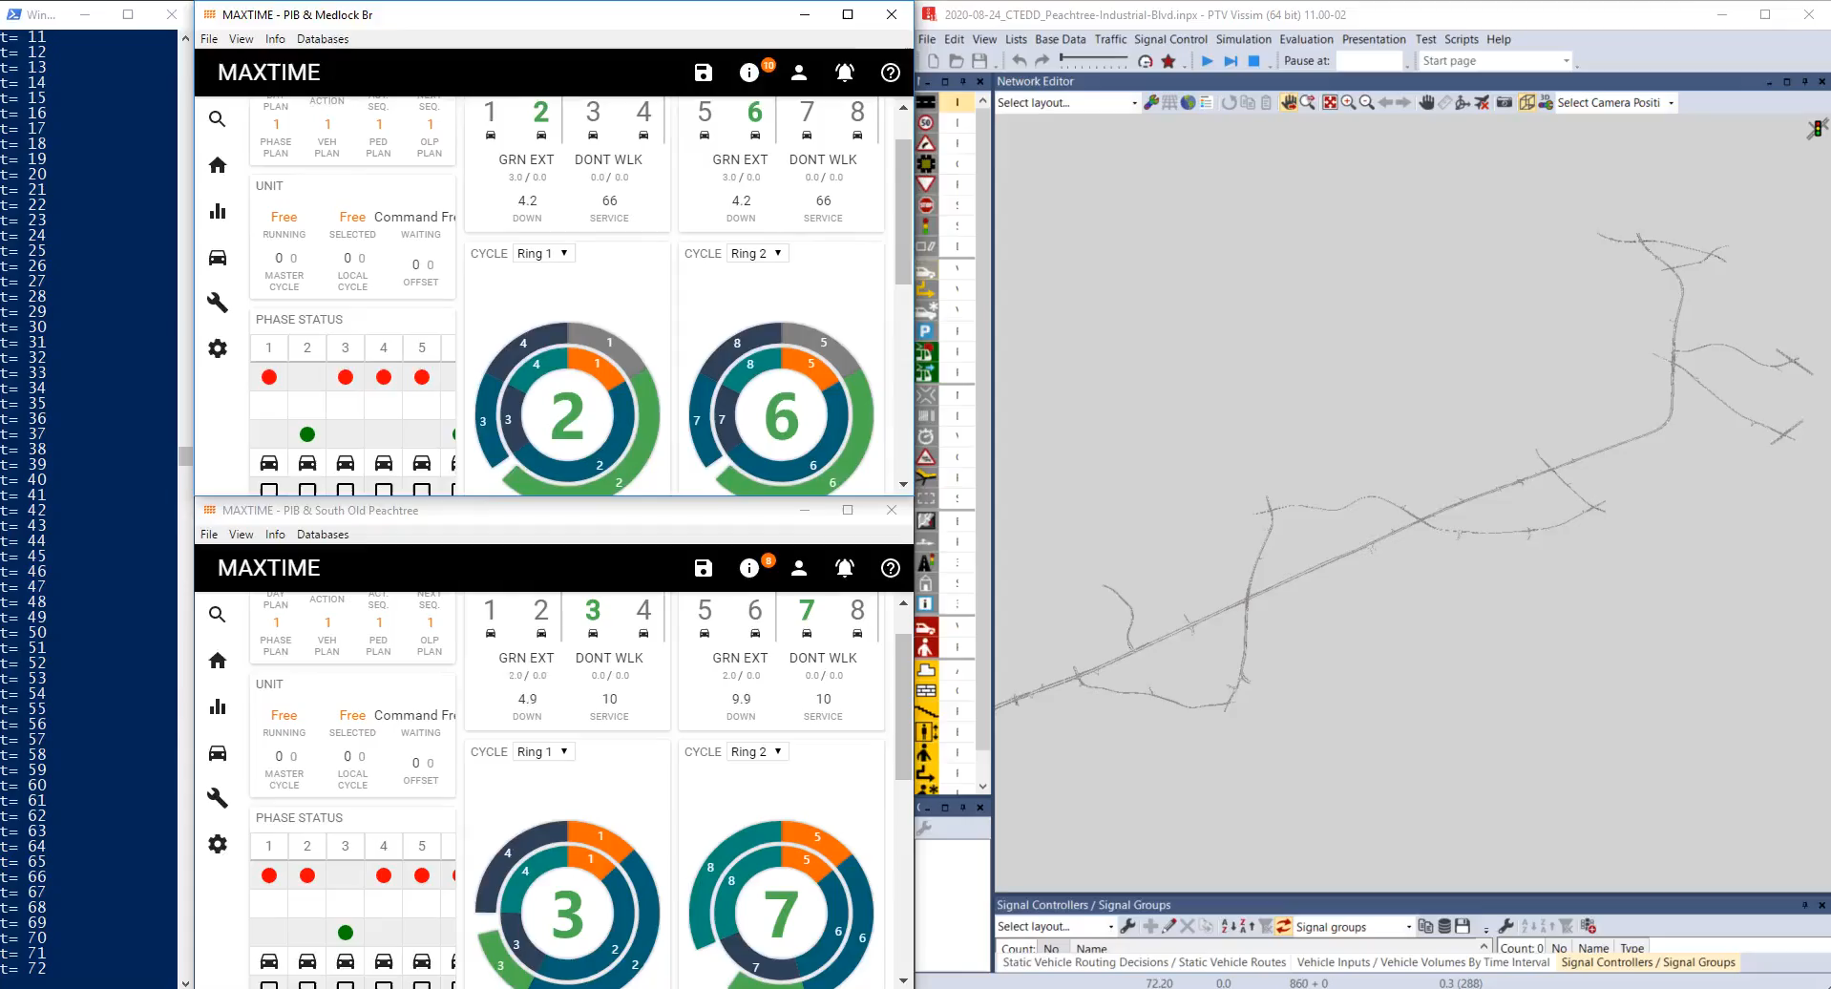
MAXTIME-VISSIM-COM Demonstration

Slide 13
SILS Model Building Tasks Remaining
Imputing in the turn counts based on ARC’s ABM20 or another alternative sources.
Automating the process of connecting multiple instances of MAXTIME to VISSIM
Connecting detector data (output) in VISSIM to MAXTIME in real-time

